Slide 1


MACHINE LEARNING INTERPRETABILITY WITH LIME AND SHAP
Omar A. Jiménez-Negrón
ESMA4016 Data Mining & Machine Learning
Final Project

Slide 2
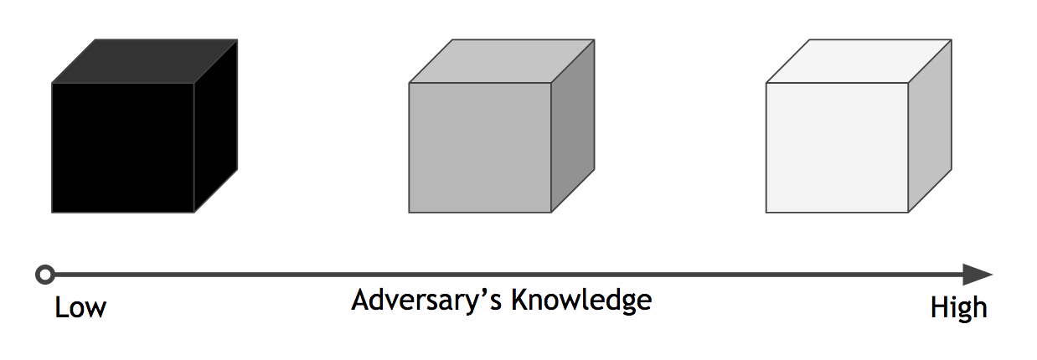

THE ACCURACY-INTERPRETABILITY TRADE-OFF…
Accurate Interpretable
✓
⨯
Complex
Simple
Input
Output
⨯
✓
Input
Output
Choose one.

Slide 3
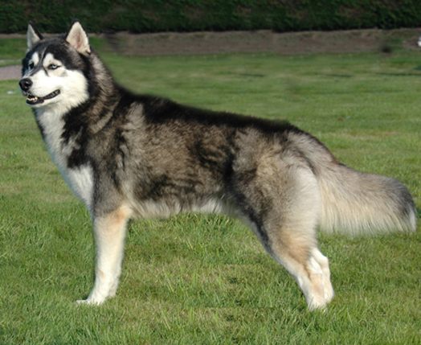
INTERPRETABILITY EXAMPLE
Let’s suppose a Husky vs Wolf image classifier is trained and the following information is obtained:
The classifier has a 90% test accuracy – great!
Here are some examples of its predictions (including one it got wrong)
✓
✓
⨯
Would you trust this classifier?
(No! This is really a snow/grass detector, not a Husky vs Wolf classifier)

Slide 4

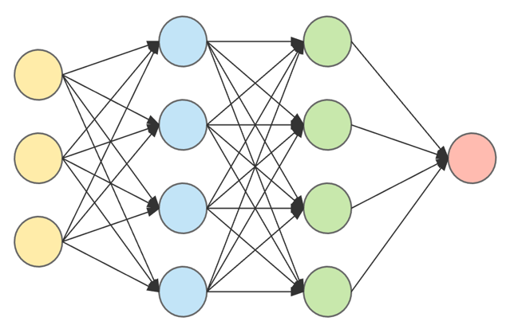
INTERPRETABILITY: WHAT IS IT? WHY IS IT IMPORTANT?
“The ability to explain or to present in understandable terms to a human”
Often there are applications where we need ML models to be interpretable, and not just be accurate
If users do not trust a model or a prediction, they will not use it!
This patient has COVID-19!
Why? Because the model says so? ⨯
Ok ✓
Patient Symptoms
Fever ✓
Dry cough ✓
Tiredness ✓
Loss of smell ⨯
This patient has COVID-19!
MODEL
MODEL
PREDICTIONS/EXPLANATIONS
DOCTORS
DOCTORS

Slide 5
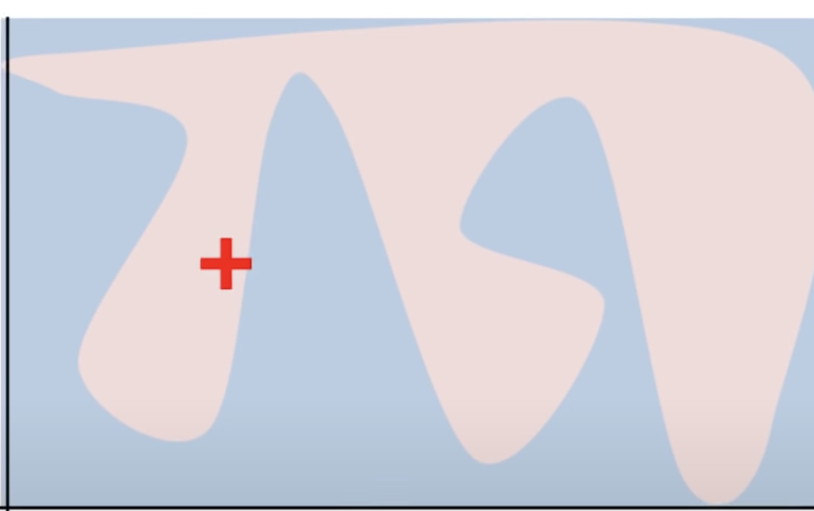
Local Interpretable Model-agnostic Explanations (LIME)
Ribeiro, Singh & Guestrin SIGKDD (2016)
locally-faithful decision boundary
Globally, a linear model will obviously not be good. But near the data point, a linear model locally actually describes the model pretty well!

Slide 6
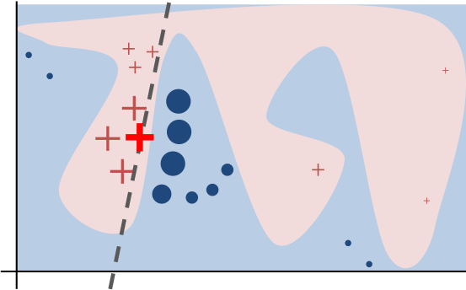
Local Interpretable Model-agnostic Explanations (LIME)
The way LIME works can be explained intuitively in the following way
Perturb data (sample points around x_{i})
Use complex model to predict labels for new data
Calculate distance between perturbations and original observations
Weigh samples according to distance from x_{i}
Learn new simple model (e.g. linear, DT) from weighted samples
Use the simple model to provide explanations

Slide 7
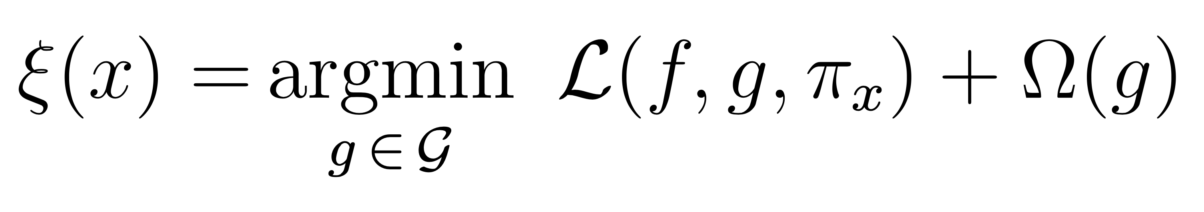
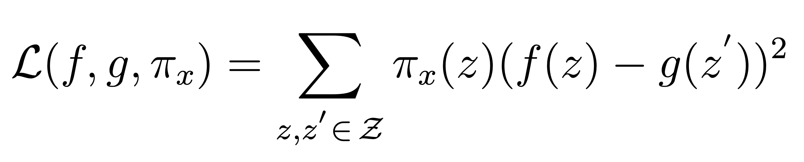
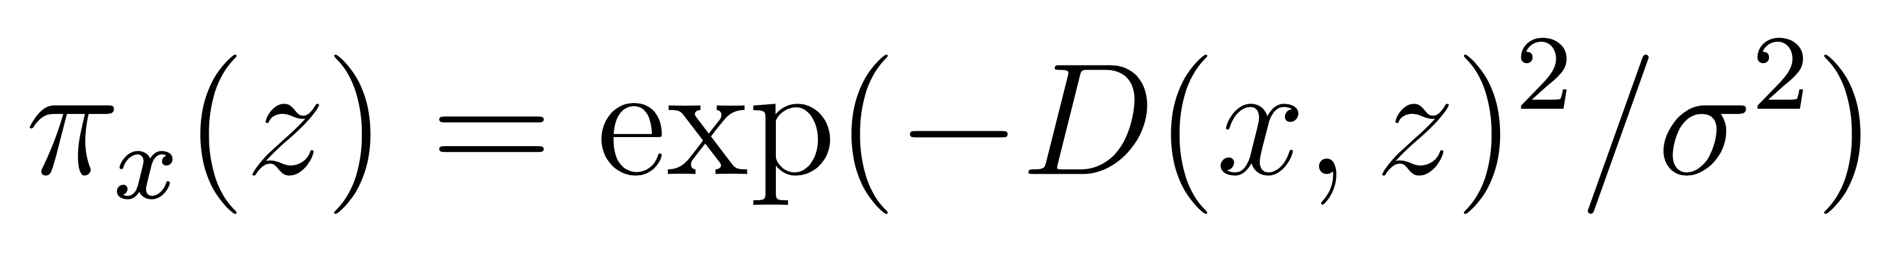
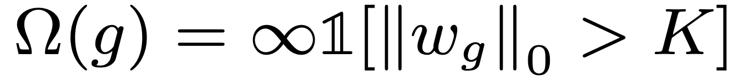
Local Interpretable Model-agnostic Explanations (LIME)
Or, mathematically…
Local kernel
Regularizer
Loss function
where
In general, we are interested in minimizing the first term, while keeping the second one low enough to ensure both local fidelity and interpretability!

Slide 8
CONVOLUTIONAL NEURAL NETWORKS (CNN)
The basis of a CNN are the convolutional layers, which make use of a mathematical operation called convolution. A convolution is, simply put, how the input is modified by filters. They are most widely used in image analysis.

Slide 9
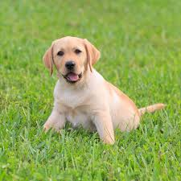

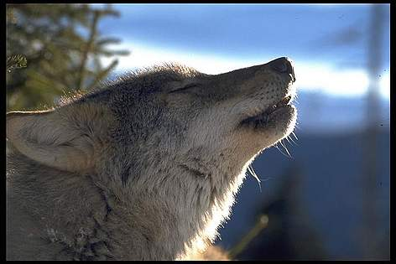
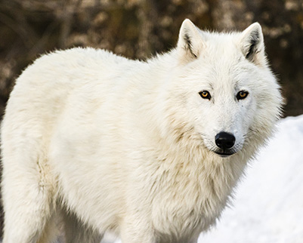
DATASET #1: DOGS VS WOLVES
Original Dataset:
https://www.kaggle.com/harishvutukuri/dogs-vs-wolves
Jupyter Notebook: https://github.com/omarjimenez4/ESMA4016/blob/master/omarjimenez_ESMA4016Project_LIME.ipynb
Data Type: Images
Task: Classification
Size: 2002 images
Test Accuracy: 75%

Slide 10
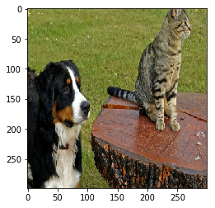
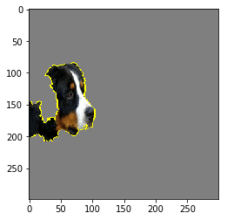
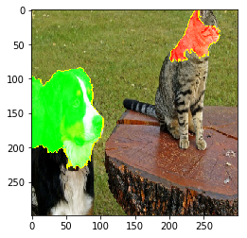
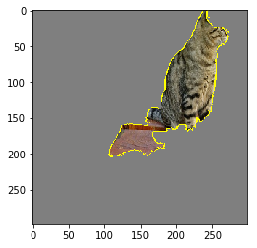
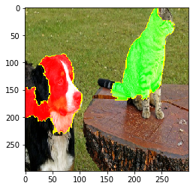
ADDITIONAL LIME EXAMPLES
Using Inception (pre-trained model)
Explanation for dog
Explanation for cat
https://github.com/marcotcr

Slide 11
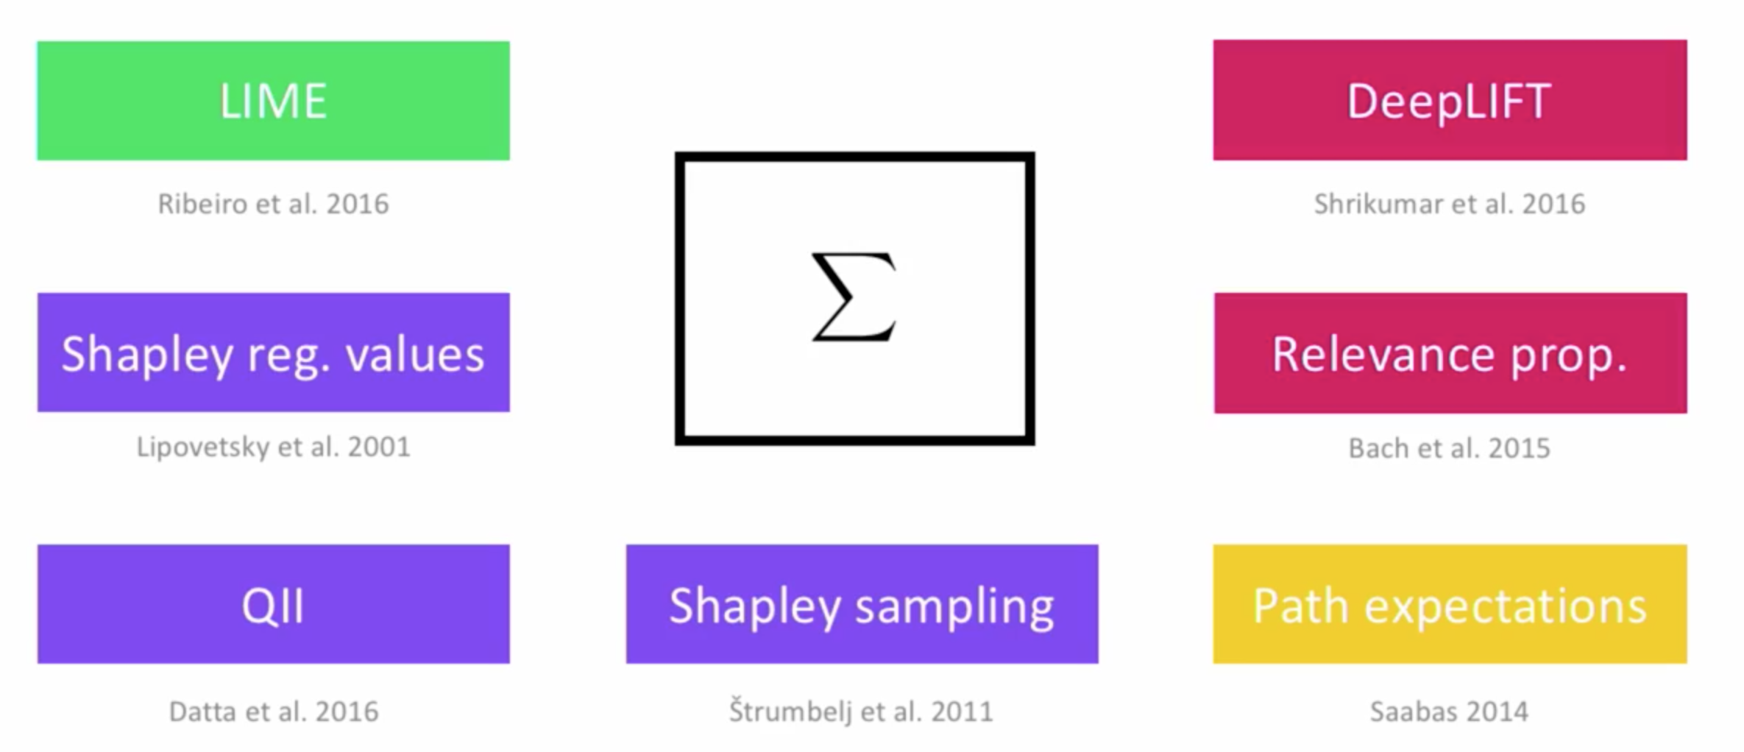
SUMMARY
LIME provides a relatively simple approach to interpret black-box models that can be approximated locally using linear models
One of the most important breakthroughs in interpretability methods, but it is not the only way to look at the problem!
It has its drawbacks: potentially unstable, inconsistent, what does local mean?
It is not the only explanation method, many others have been proposed (e.g. DeepLIFT, Shapley regression values, Shapley sampling QII, etc.)
??
What is the relationship between LIME and other explanation methods? When is one preferable over the other?

Slide 12
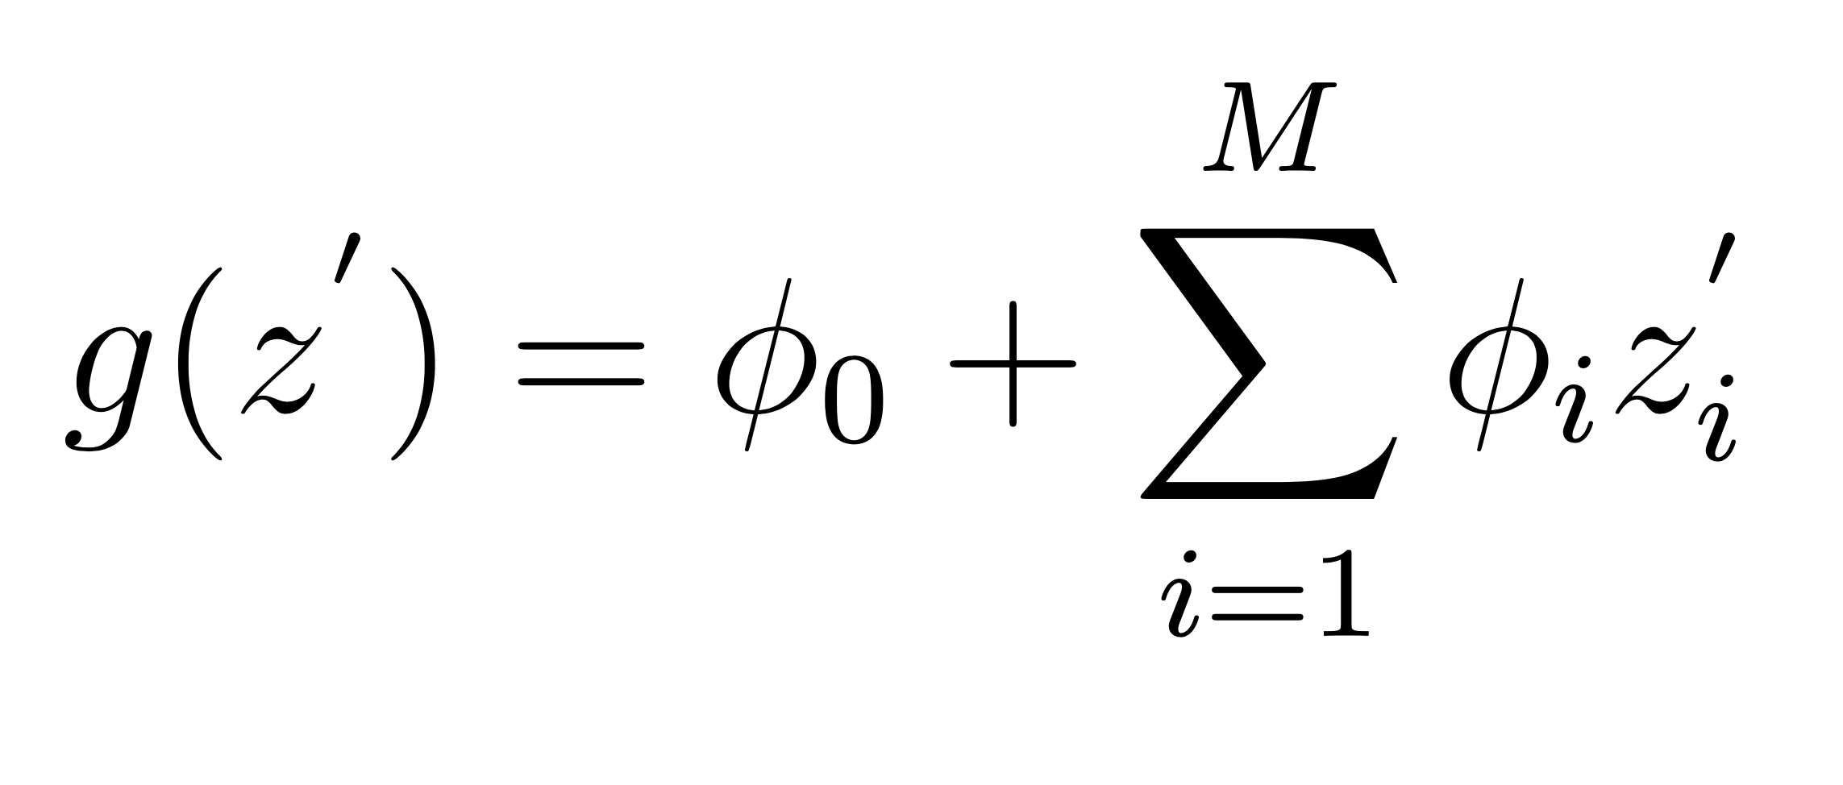
SHapley Additive exPlanation (SHAP)
Lundberg & Lee NIPS (2017)
Most explanation methods generate explanation models of the following form:
explanation model
output features toggled off
feature contribution
i.e. they are linear functions of binary variables! Lundberg et. al termed these Additive feature attribution methods.

Slide 13
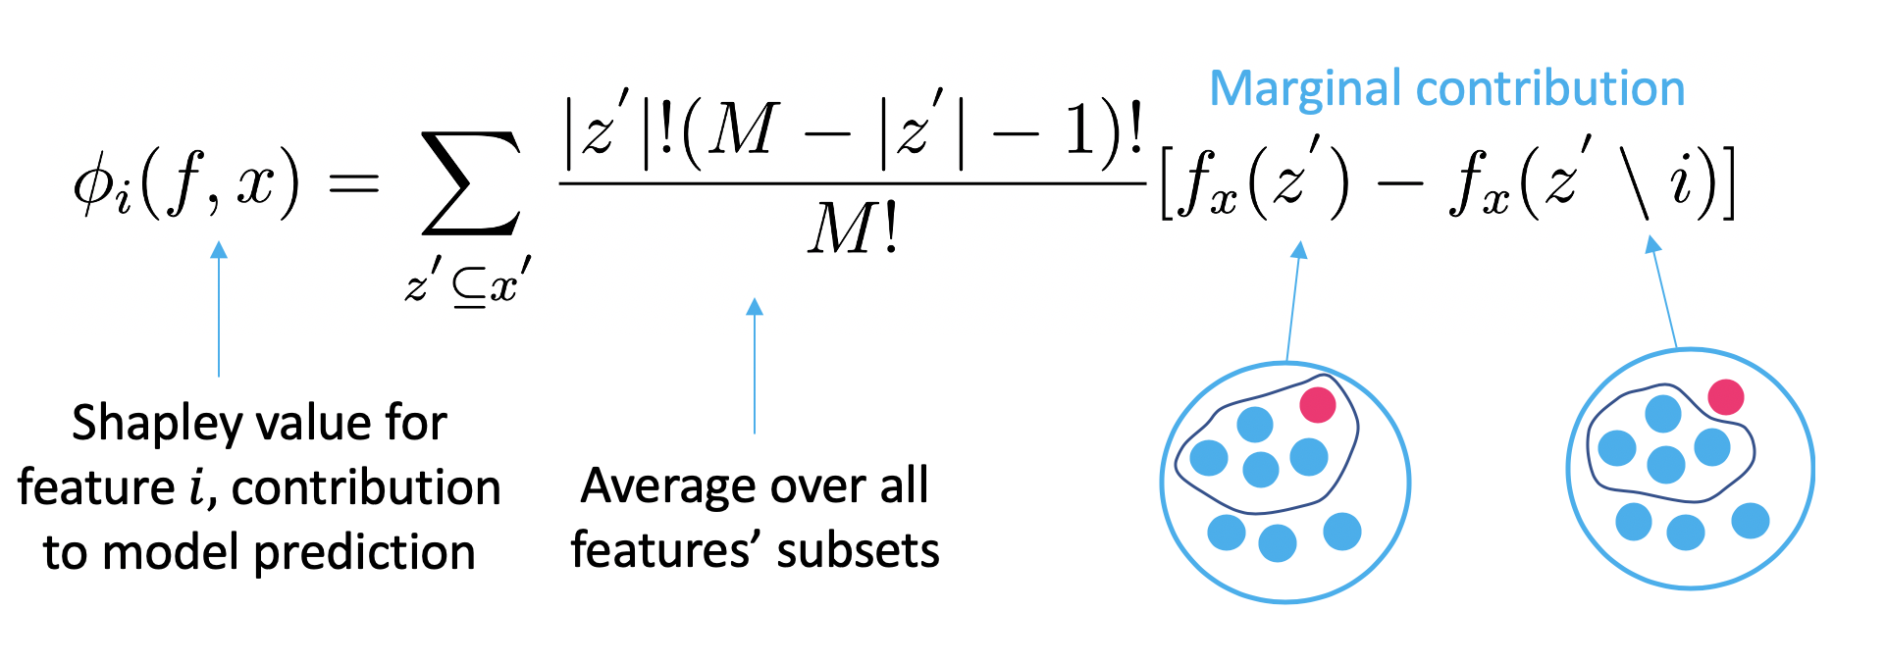
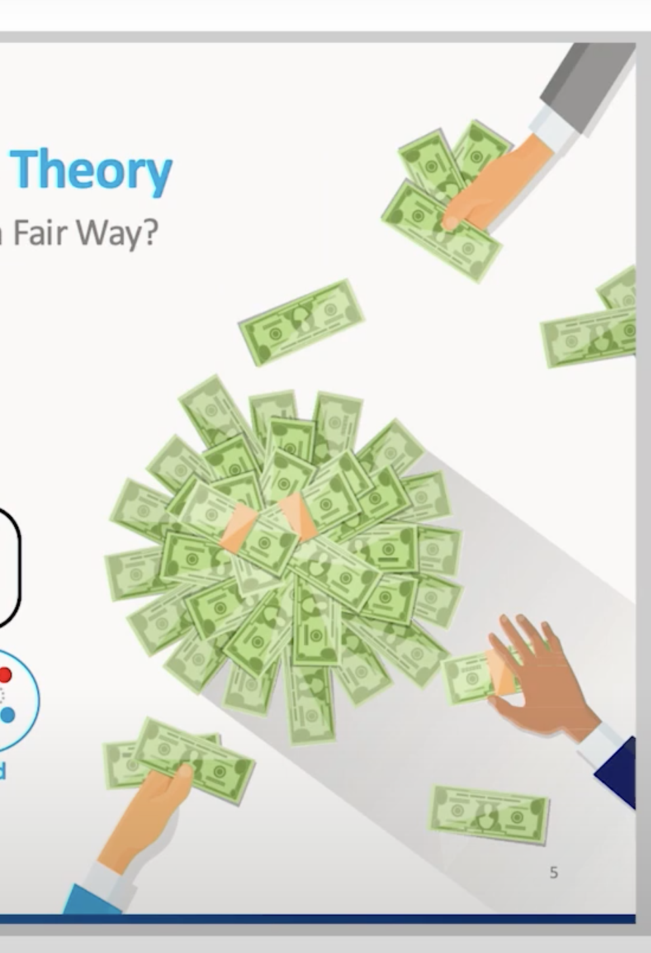
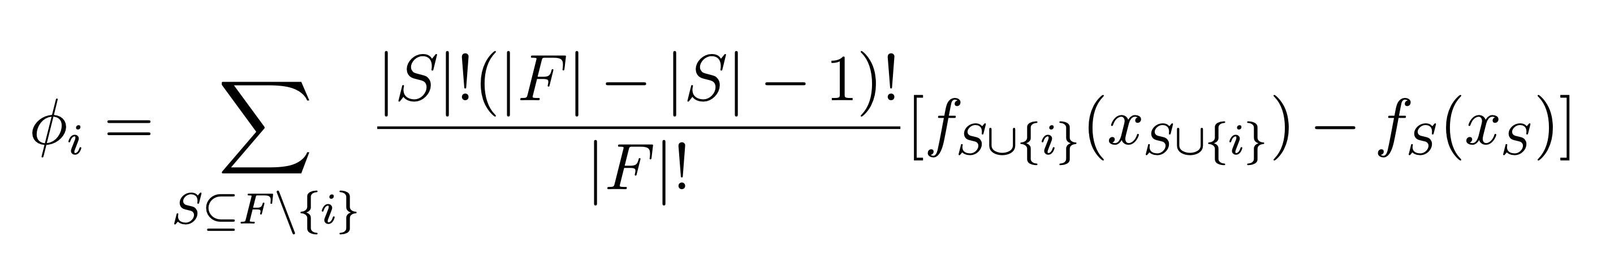


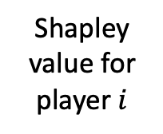
SHAPley values in Game Theory
How do we divide money between players in a fair way?
Fairness properties:
Additivity (sum of money players get together should be game result)
Consistency (if one player contributes more, he cannot get less money)
Marginal contribution
Shapley value for player $i$
Average over all players’ subsets
players→ features
game → model
These concepts can be extended to ML! But it is usually hard to solve this → often approximated

Slide 14
SHAP Algorithms
Method | How does it compute SHAP values? | How does the model deal with missing values?
shap.KernelExplainer model-agnostic approximate | Exponential-time run time! | Choosing a background dataset (training, median, all black image, etc.)
shap.TreeExplainer model-specific exact! | Polynomial-time run time! (which allows the exact solution) | Trees can handle missing values.

Slide 15
DATASET #2: BANK MARKETING
Original Dataset:
https://archive.ics.uci.edu/ml/datasets/Bank+Marketing
Jupyter Notebook:
https://github.com/omarjimenez4/ESMA4016/blob/master/omarjimenez_ESMA4016Project_LIME.ipynb
Data Type: Numerical
Task: Classification
Size: 41,188 instances
Test Accuracy: 85%

